Slide 1
ArUco handles lightweight positioning and detection of simple objects, while YOLO can identify more complex and dynamic targets. By assigning tasks to the appropriate algoithms, the system can achieve efficient real-time processing with limited resources. Combining these two technologies leverages their strengths and compensates for their weaknesses when used individually.
SKY NET
General Perception and Decision-making Strategies based on Large Language Models

Slide 2
SKY NET
Advancements in Robot Control Strategies
Major companies worldwide are placing great emphasis on using large language models to control robots.
https://chatgpt-enterprise.jp/news/openai-robot/
https://business.nikkei.com/atcl/gen/19/00466/122600028/
https://www.mitsubishielectric.co.jp/it/it-words/keyword-ai/
https://prtimes.jp/main/html/rd/p/000000005.000139489.html
ArUco handles lightweight positioning and detection of simple objects, while YOLO can identify more complex and dynamic targets. By assigning tasks to the appropriate algoithms, the system can achieve efficient real-time processing with limited resources. Combining these two technologies leverages their strengths and compensates for their weaknesses when used individually.

Slide 3
SKY NET
Project Concept
Advancements in Robot Control Strategies
The application of LLMs, such as ChatGPT, in robotic control systems offers the potential to establish highly adaptive and generalized control strategies. By leveraging standardized inputs that encode human understanding and universal rules, LLMs can effectively orchestrate the execution of complex tasks. These standardized inputs, analogous to traffic regulations, provide a formalized structure that ensures robots exhibit expected behaviors across diverse scenarios.
Unlike traditional control strategies, LLM-based systems leverage adaptive and memory mechanisms, allowing robots to address complex logical relationships and non-trivial problem-solving tasks. When confronted with similar operational contexts, LLMs extend beyond executing predefined rules by dynamically refining their control strategies through self-learning and feedback mechanisms. This capability empowers robotic systems to respond effectively to dynamic environments, surpassing the limitations of conventional rule-driven frameworks.
ArUco handles lightweight positioning and detection of simple objects, while YOLO can identify more complex and dynamic targets. By assigning tasks to the appropriate algoithms, the system can achieve efficient real-time processing with limited resources. Combining these two technologies leverages their strengths and compensates for their weaknesses when used individually.

Slide 4
SKY NET
Project Concept
Towards Breakthroughs in Artificial General Intelligence
As artificial general intelligence (AGI) continues to evolve, LLMs are expected to acquire more sophisticated reasoning capabilities and probabilistic modeling techniques. These advancements will enable robots to devise intelligent control strategies through iterative reasoning and experimental optimization. Such methodologies transcend traditional rigid-rule frameworks by fostering continuous learning and adaptive refinement to achieve optimal outcomes.
Ultimately, models such as ChatGPT transcend their role as mere computational tools, serving as a robust interface that facilitates seamless and efficient interactions between humans and robots. Within this paradigm, human-defined norms act as the "traffic regulations," sensor-derived inputs represent streams of data from the physical world, and the processed outputs manifest as actionable robotic behaviors, bridging the gap between human intent and machine execution.
ArUco handles lightweight positioning and detection of simple objects, while YOLO can identify more complex and dynamic targets. By assigning tasks to the appropriate algoithms, the system can achieve efficient real-time processing with limited resources. Combining these two technologies leverages their strengths and compensates for their weaknesses when used individually.

Slide 5
SKY NET
Basic Framework
Artificial General Intelligence
ArUco handles lightweight positioning and detection of simple objects, while YOLO can identify more complex and dynamic targets. By assigning tasks to the appropriate algoithms, the system can achieve efficient real-time processing with limited resources. Combining these two technologies leverages their strengths and compensates for their weaknesses when used individually.
Enhancing Reasoning Capabilities
in Artificial General Intelligence
Information from the Physical World
Input
ChatGPT-LLM
Output
Behavioral Outcome Categories
Human Instructions
Semantic Standardization
Semantic Standardization of Human Knowledge

Slide 6
SKY NET
Basic Framework
1.Input Section:
Includes information from the physical world (e.g., sensor data, environmental perception) .
human instructions (e.g., natural language input or operational commands).
2.Core Module:ChatGPT-LLM:
Serves as the primary platform for a general-purpose language model (LLM), responsible for processing input information.
It normalizes human knowledge and semantic input to better understand and execute tasks.
3.Reasoning and Decision-Making:
Enhanced Reasoning Capabilities: Employs logical reasoning through Artificial General Intelligence (AGI) to enable more complex task decision-making.
Generates adaptive outputs based on inputs and predefined rules, allowing the system to adjust to environmental changes.
4.Output Section:
Produces actionable results (e.g., robot motion commands, system feedback).
After interacting with the physical environment, the outputs can be adjusted based on received feedback.
5.Feedback Loop Mechanism:
The resulting behavior is perceived and fed back into the system. After being processed and normalized, it further refines and optimizes the model's decision-making capabilities.
ArUco handles lightweight positioning and detection of simple objects, while YOLO can identify more complex and dynamic targets. By assigning tasks to the appropriate algoithms, the system can achieve efficient real-time processing with limited resources. Combining these two technologies leverages their strengths and compensates for their weaknesses when used individually.

Slide 7
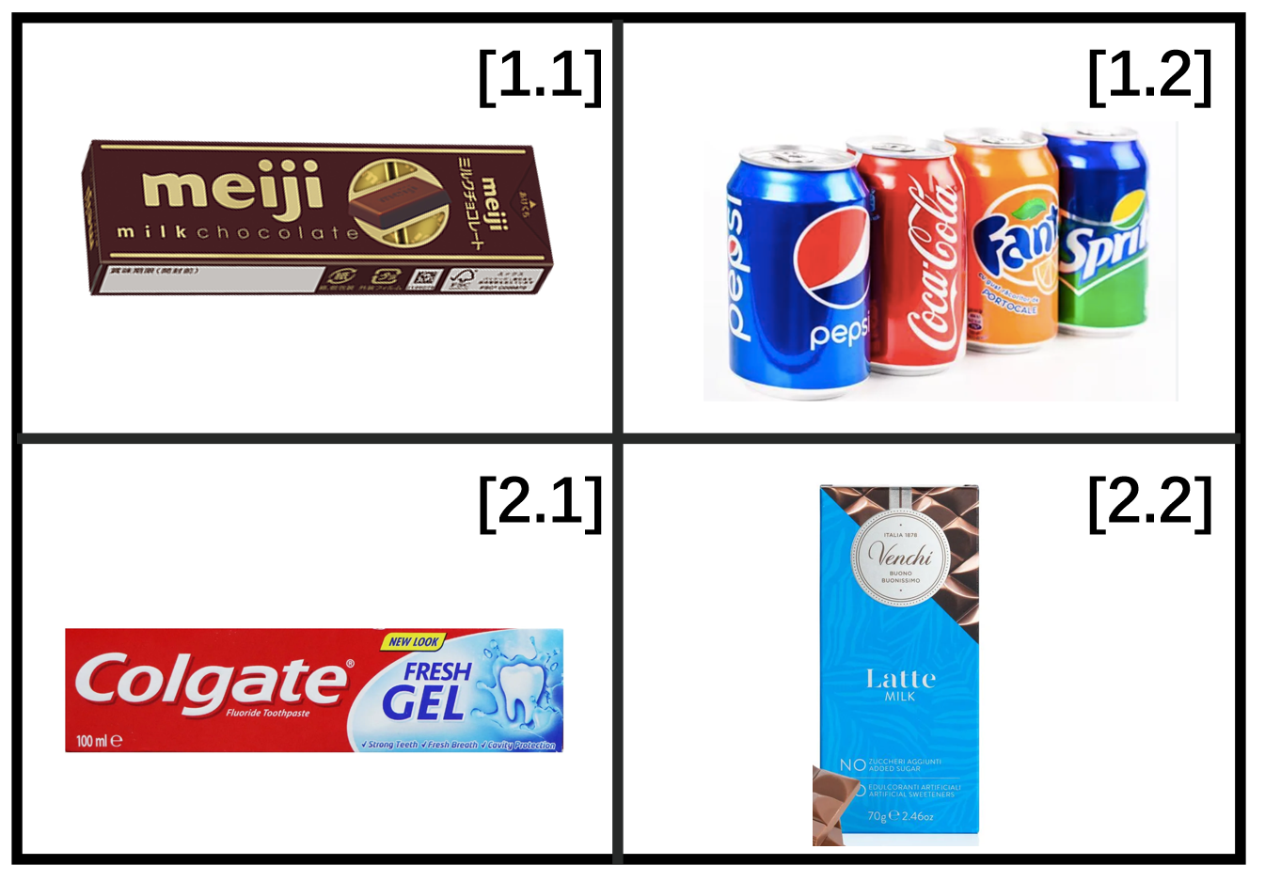
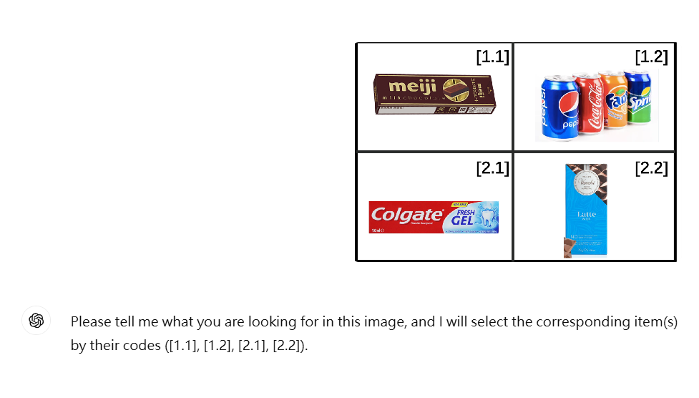
SKY NET
Robotic Arm Problem: Coordinates and Recognition
ArUco handles lightweight positioning and detection of simple objects, while YOLO can identify more complex and dynamic targets. By assigning tasks to the appropriate algoithms, the system can achieve efficient real-time processing with limited resources. Combining these two technologies leverages their strengths and compensates for their weaknesses when used individually.
Fig 1: Object Recognition via a Pre-trained Large Language Model (LLM)

Slide 8


SKY NET
Robotic Arm Problem: Coordinates and Recognition
ArUco handles lightweight positioning and detection of simple objects, while YOLO can identify more complex and dynamic targets. By assigning tasks to the appropriate algoithms, the system can achieve efficient real-time processing with limited resources. Combining these two technologies leverages their strengths and compensates for their weaknesses when used individually.
Fig 2: Robust Text Image Recognition with Reasoning Capabilities

Slide 9
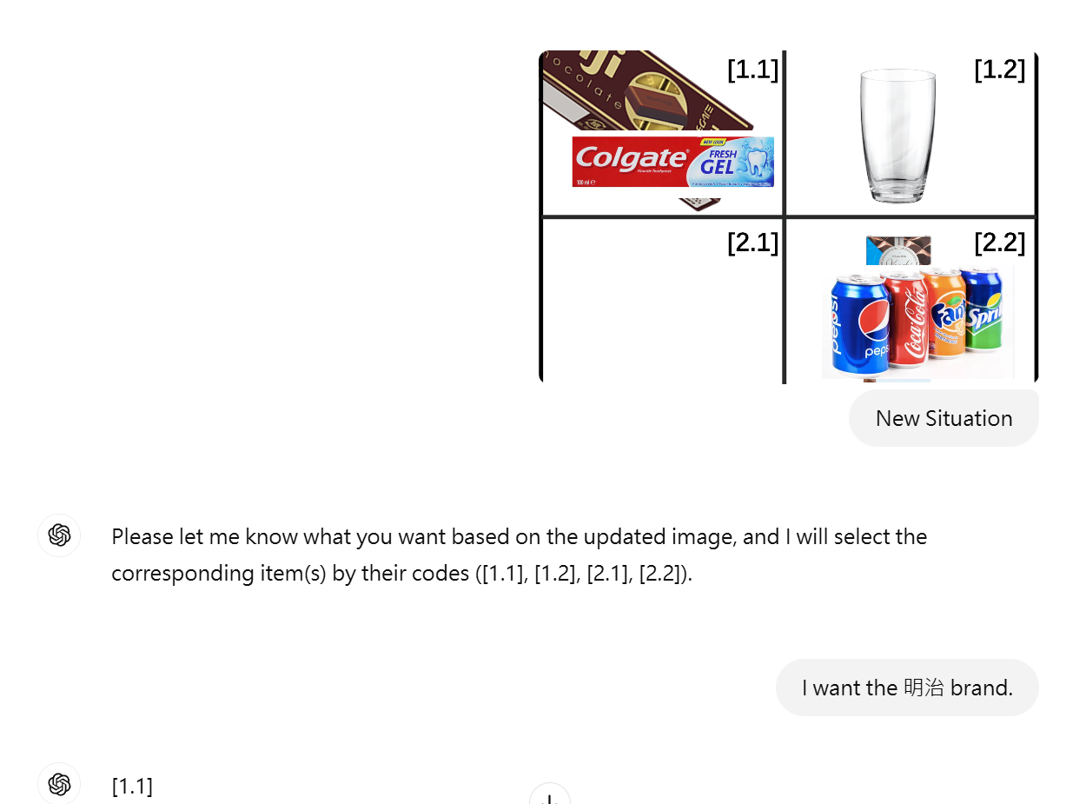
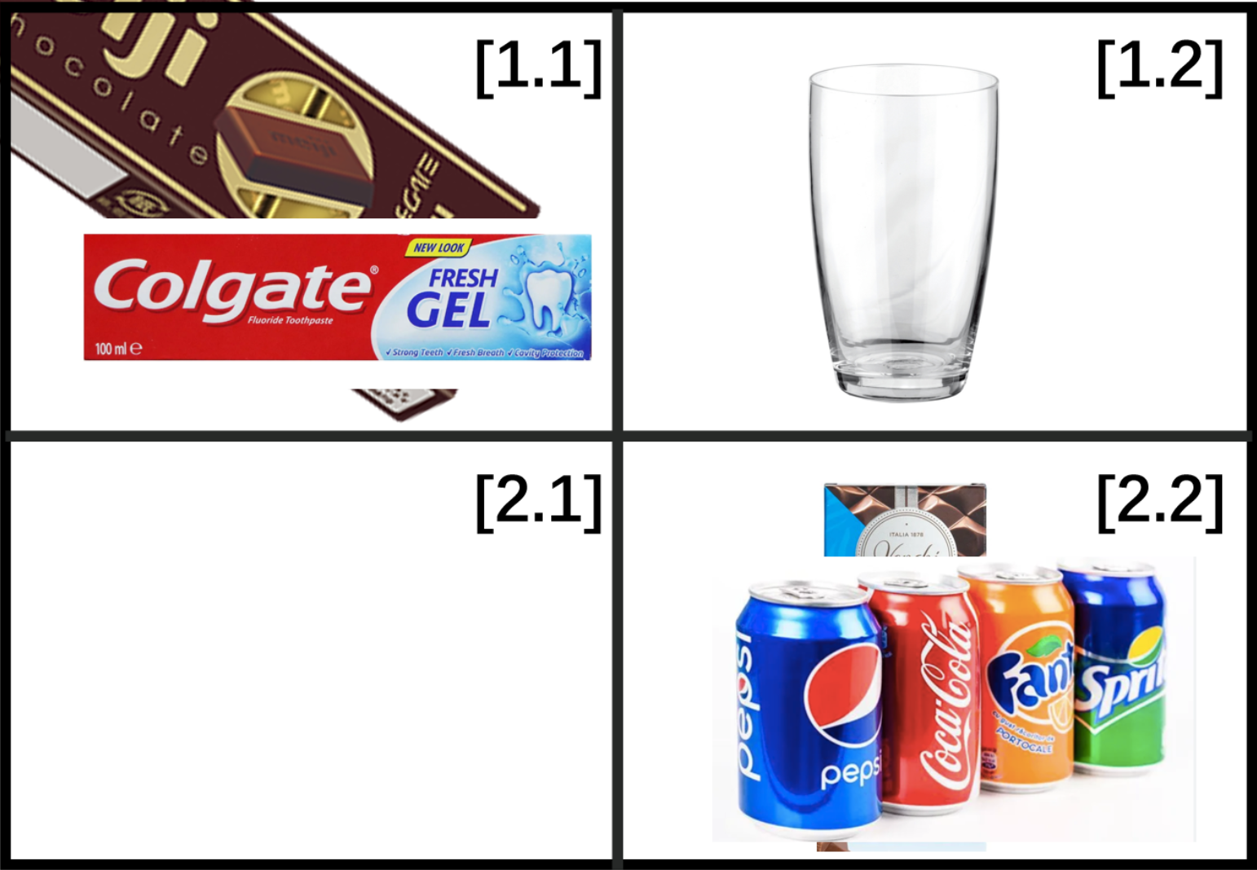
SKY NET
Robotic Arm Problem: Coordinates and Recognition
Occlusion can lead to the loss of partial or complete feature information of the target object, making it challenging for traditional detection algorithms based on geometric shapes, texture features, or color to accurately identify the target.
Fig 3: Occlusion Object Recognition

Slide 10
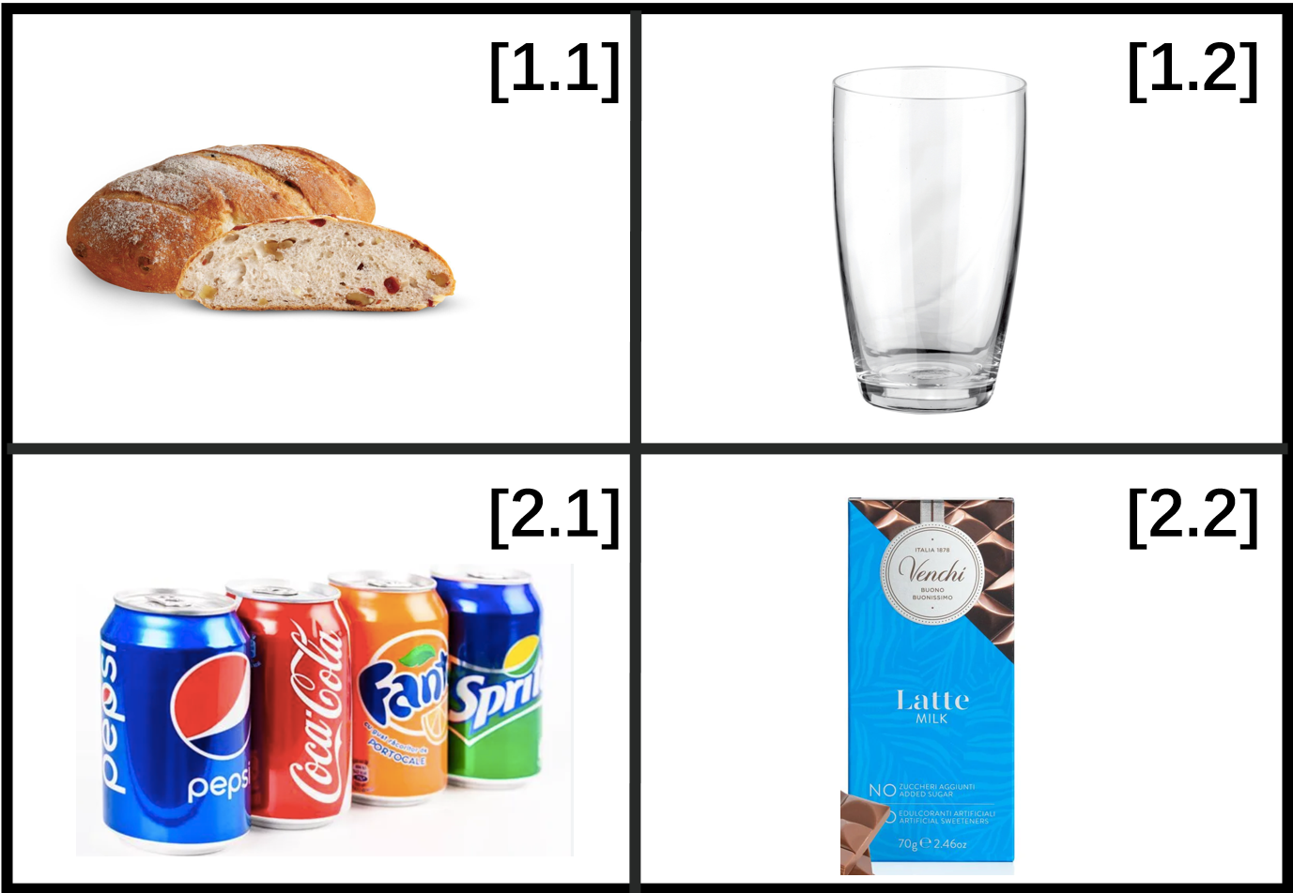
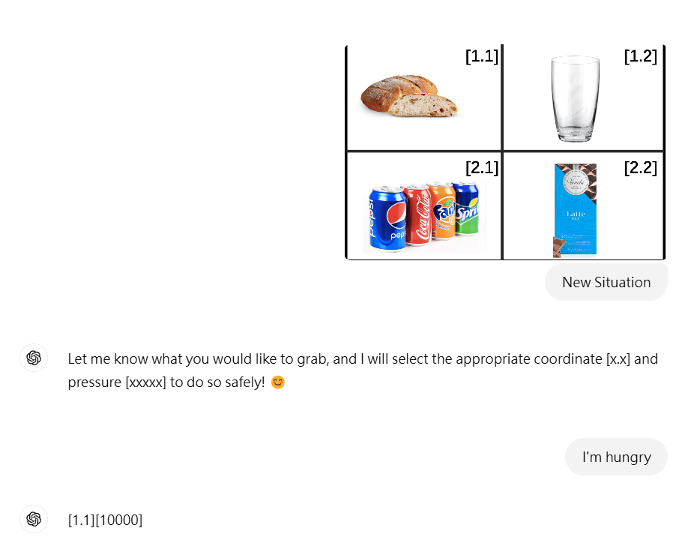
SKY NET
Robotic Arm Problem: Visual Dynamic bjects
In the process of robotic arm grasping, force control and stability are crucial. Excessive grasping force may damage the object, while insufficient force can cause the object to fall, thereby affecting the success rate of the task. Therefore, by combining the educational strategy with ChatGPT's analytical capabilities, I identify the characteristics of the object and estimate its approximate mass. At the same time, utilizing pre-learned mathematical formulas, I accurately calculate the required range of grasping force, ensuring stability and safety during the grasping process.
Fig 4: Formula Parsing and Evaluation

Slide 11
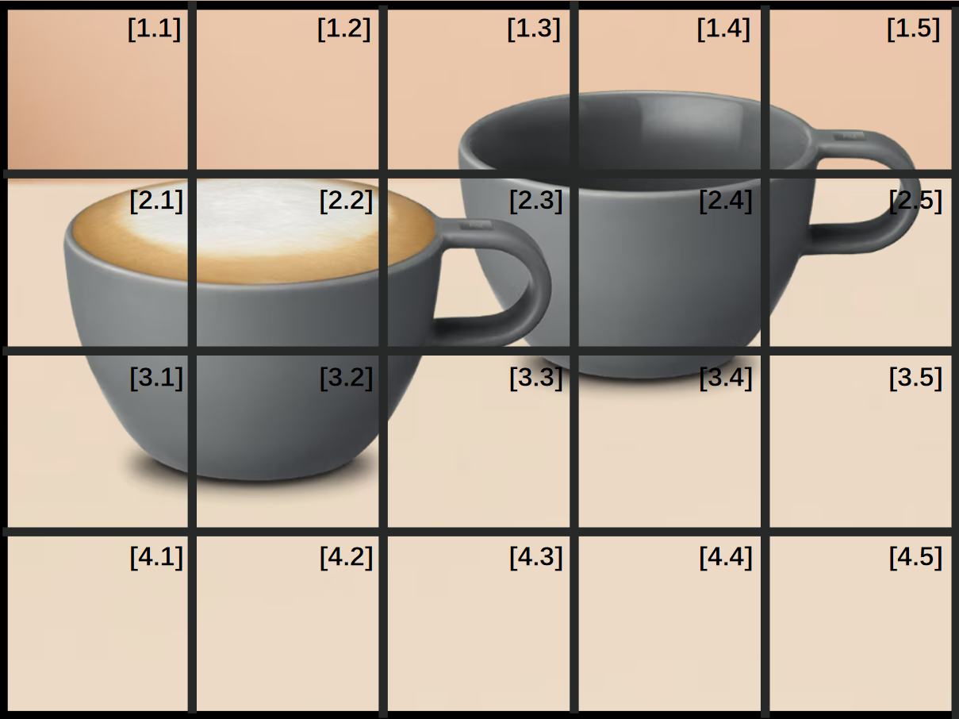
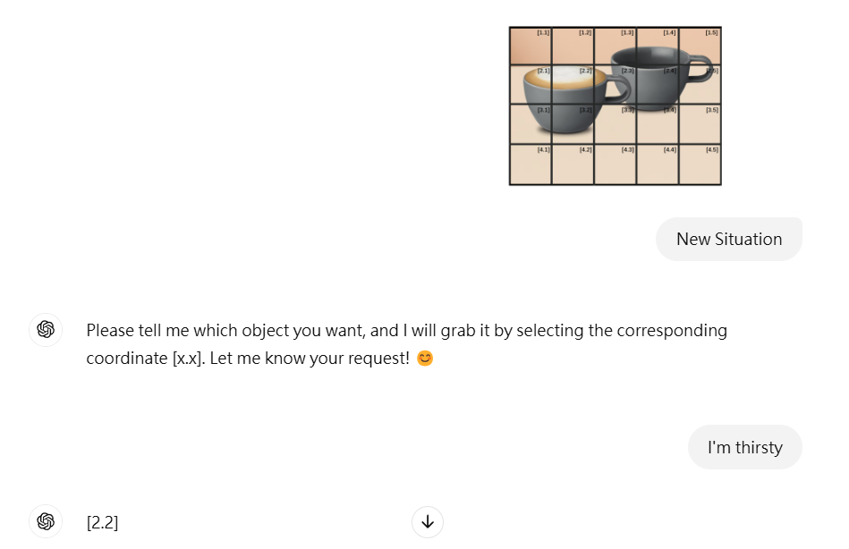
SKY NET
Robotic Arm Problem: Determination of the Grasping Point
Determining the grasping point is a critical challenge, as selecting an appropriate position directly influences the success rate and stability of the grasping process. ChatGPT, when utilizing the initial phase of the training strategy, can effectively handle most tasks. If challenges are encountered, the training strategy can be further refined to learn from human behaviors and enhance the grasping process.
ArUco handles lightweight positioning and detection of simple objects, while YOLO can identify more complex and dynamic targets. By assigning tasks to the appropriate algoithms, the system can achieve efficient real-time processing with limited resources. Combining these two technologies leverages their strengths and compensates for their weaknesses when used individually.
Fig 5: Grasping Point and Target Selection via Position Mapping

Slide 12
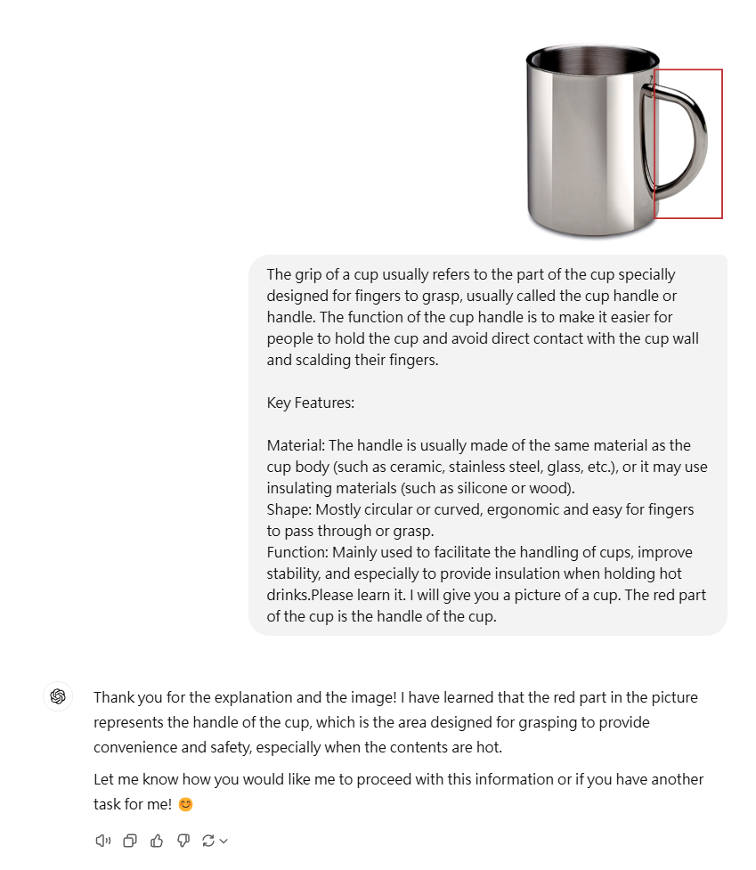
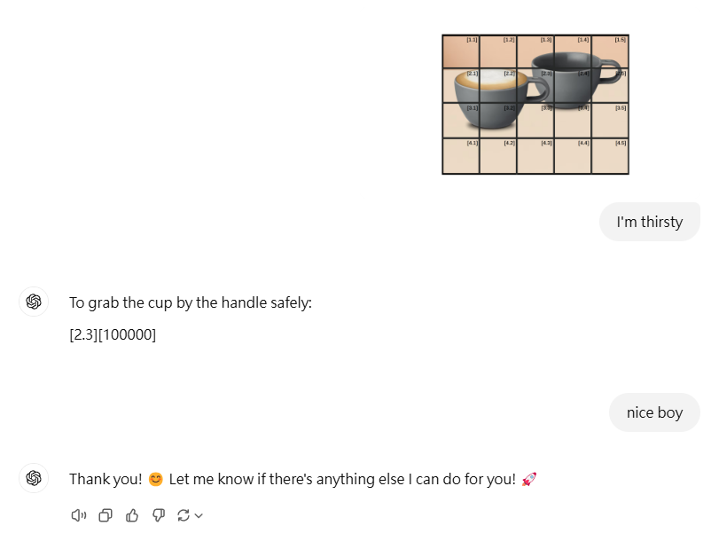
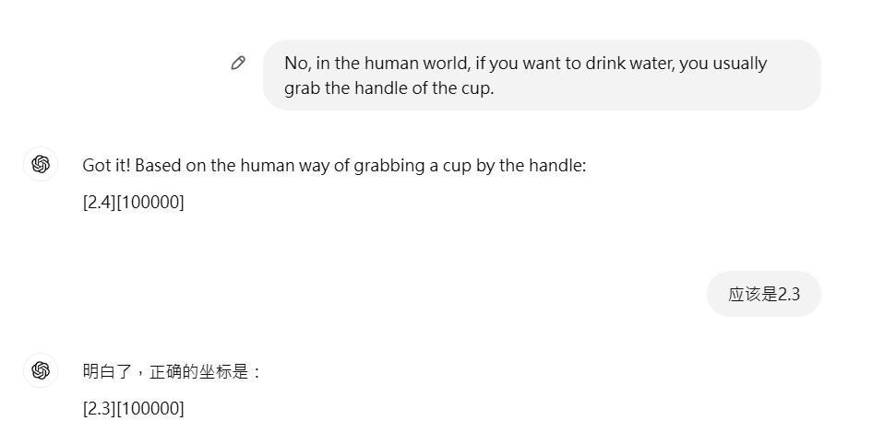
SKY NET
Robotic Arm Problem: Determination of the Grasping Point
ArUco handles lightweight positioning and detection of simple objects, while YOLO can identify more complex and dynamic targets. By assigning tasks to the appropriate algoithms, the system can achieve efficient real-time processing with limited resources. Combining these two technologies leverages their strengths and compensates for their weaknesses when used individually.
Fig 6: Semantic Standardization of Human Knowledge

Slide 13
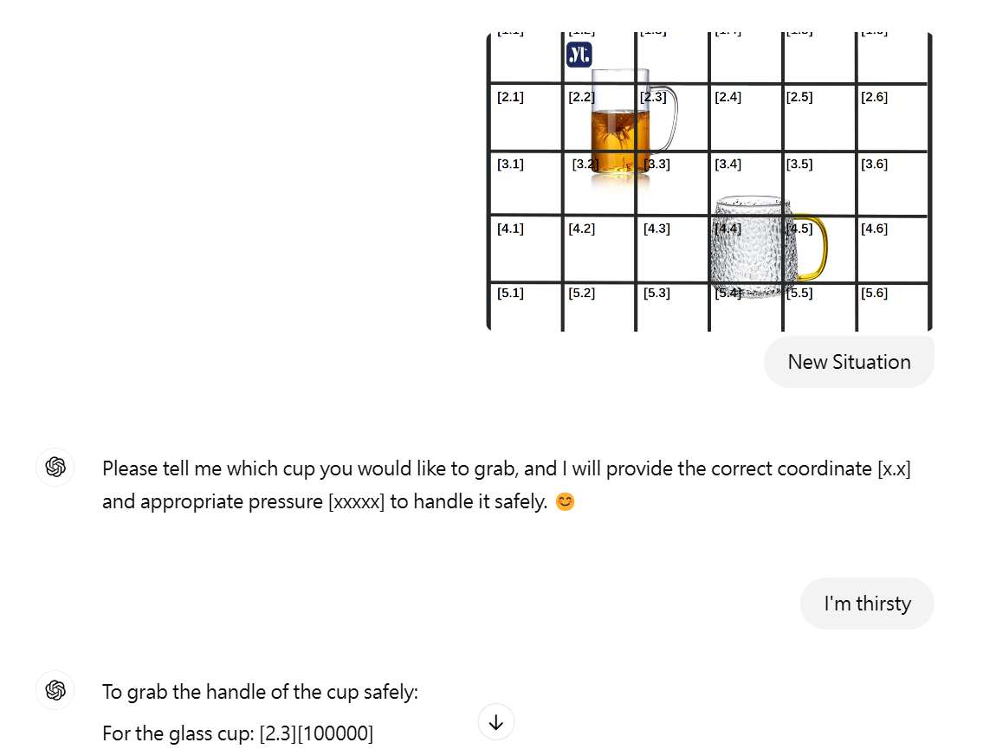
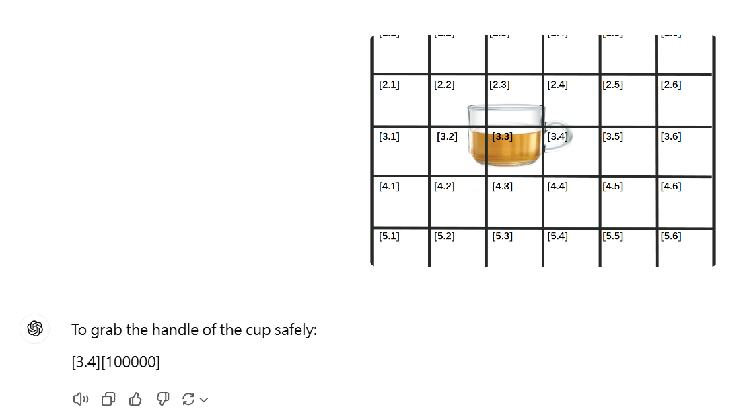
SKY NET
Robotic Arm Problem: Determination of the Grasping Point
ArUco handles lightweight positioning and detection of simple objects, while YOLO can identify more complex and dynamic targets. By assigning tasks to the appropriate algoithms, the system can achieve efficient real-time processing with limited resources. Combining these two technologies leverages their strengths and compensates for their weaknesses when used individually.
Fig7: Results of Semantic Standardization

Slide 14

SKY NET
Summarize-汎用性
The ChatGPT-based robotic system demonstrates strong generality due to its ability to comprehend natural language, support multimodal data processing, and excel in contextual reasoning and adaptability. By leveraging pre-trained knowledge bases and expert experience, it can address a wide range of tasks while generating outputs aligned with standardized industry requirements. Additionally, the system offers high integrability, enabling seamless collaboration with open-source control systems to achieve a complete end-to-end workflow from design to execution. With a cyclic feedback mechanism, ChatGPT dynamically adjusts behaviors and optimizes decision-making, ensuring stable and efficient performance across various domains and complex environments. These features position ChatGPT as a versatile, intelligent, and highly applicable general-purpose system solution.
ArUco handles lightweight positioning and detection of simple objects, while YOLO can identify more complex and dynamic targets. By assigning tasks to the appropriate algoithms, the system can achieve efficient real-time processing with limited resources. Combining these two technologies leverages their strengths and compensates for their weaknesses when used individually.

